Slide 1
E-learning: Pluses and Minuses
by Rodionova E.S 24944
Bulankin M.Y 24944

Slide 2
Presentation plan
1.What is E-learning?
2. The first electronic learning system - PLATO
3.Pluses and Minuses

Slide 3

What is E-learning?
E-learning is a way of learning using electronic tools, like the internet and computers. It allows people to study remotely, access courses and materials anytime and anywhere.

Slide 4
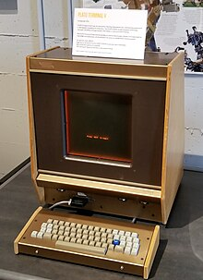
The first electronic learning system - PLATO
The first e-learning looked like a computer training program PLATO (Programmed Logic for Automatic Teaching Operations), developed at the University of Illinois in 1960. Students interacted with PLATO through terminals connected to a mainframe and networked together. Students answered questions and immediately received feedback from the system. A television was used as a display, and a special keyboard was offered for navigation.
PLATO V terminal

Slide 5

E-learning: Pluses
1.Flexibility of schedule
2.Personalization of the program
3.Freedom of access
4.Savings
5.Quality knowledge

Slide 6

E-learning: Minuses
1.Adaptation
2.Unpreparedness of students
3.Lack of personnel
4.Lack of live communication

